Slide 1
Angular
Anil K

Slide 2
Services
The service is a class contains re-usable code (business logic, validations, calculations etc.), which can be called in one or more components. If you place the re-usable set of properties and methods as a service class, it can be called from any component or any other service in the entire application.
We must decorate the service class with “@Injectable()” decorator, to make the service accessible from any other component. You can import “@Injectable” decorator from “@angular/core” package.
We must use “@Inject()” decorator, to request angular to create an object for the service class. Then the angular framework will automatically creates an object for the service class and passes the object as argument for your component’s constructor; you can receive it into a reference variable in the constructor. You can use “@Inject” only in the constructor of component. To make the reference variable as member of the component class, add “private” or “public” keyword at left side of the reference variable in the constructor.
In real time, all the CRUD operations (Ajax calls) are created in the service; the same is called in the component class, whenever required.

Slide 3
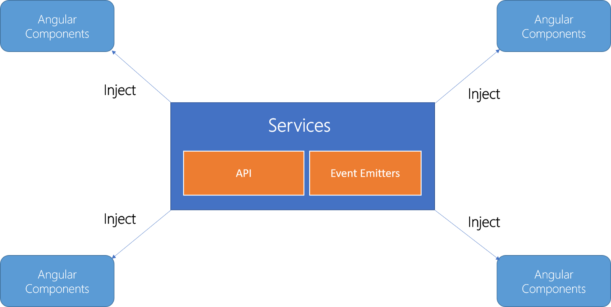

Slide 4
Steps to handle event:
Create Service:
import { Injectable } from “@angular/core”;
@Injectable( )
class Serviceclassname { Methods here }
Add service as provider in the component:
@Component( { …, providers: [ Serviceclassname ] } )
class ComponentClassname { }
(or) Add service as provider in the module:
@NgModule( { providers: [ Serviceclassname ] } )
class ModuleClassname { }
Get the instance of service using dependency injection:
import { Inject } from “@angular/core”;
@Component( { … } )
class ComponentClassname {
constructor(@Inject(Serviceclassname) variable : Serviceclassname) { }
}

Slide 5
Services - Example
Creating Application
Open Command Prompt and enter the following commands:
cd c:\angular ng new my-app
cd c:\angular\my-app
ng g class User
ng g service Login
c:\angular\my-app\src\app\app.module.ts
import { BrowserModule } from '@angular/platform-browser’;
import { NgModule } from '@angular/core’;
import { AppComponent } from './app.component’;
import { FormsModule } from "@angular/forms";
import { LoginService } from "./login.service";
@NgModule({
declarations: [ AppComponent ],
imports: [ BrowserModule, FormsModule ],
providers: [ LoginService ],
bootstrap: [AppComponent]
})
export class AppModule { }

Slide 6
c:\angular\app1\src\app\app.component.html
<div>
<form>
<h4>Services</h4>
Username: <input type="text" [(ngModel)]="username" name="username" #t1><br>
Password: <input type="password" [(ngModel)]="password" name="password"><br> <input type="submit" value="Login" (click)="CheckLogin(t1)"><br>
{{msg}}
</form>
</div>
c:\angular\app1\src\app\app.module.ts
import { BrowserModule } from '@angular/platform-browser’;
import { NgModule } from '@angular/core’;
import { AppComponent } from './app.component’;
import { FormsModule } from "@angular/forms";
import { LoginService } from "./login.service";
@NgModule({
declarations: [ AppComponent ],
imports: [ BrowserModule, FormsModule ],
providers: [ LoginService ],
bootstrap: [AppComponent]
}) export class AppModule { }

Slide 7
c:\angular\app1\src\app\user.ts
export class User {
username: string;
password: string;
constructor(a: string, b: string) {
this.username = a;
this.password = b;
}
}
c:\angular\app1\src\app\login.service.ts
import { Injectable } from '@angular/core’;
import { User } from "./user";
@Injectable() export class LoginService {
users: User[] = [
new User("scott", "scott123"),
new User("smith", "smith123"),
new User("allen", "allen123"),
];
constructor() { }
checkUsernameAndPassword(username: string, password: string): boolean {
var count = 0;
for (var i = 0; i < this.users.length; i++) {
if (this.users[i].username == username && this.users[i].password == password){
count++;
}
}
if (count == 1){
return true;
}else{
return false;
}
}
}

Slide 8
c:\angular\app1\src\app\app.component.ts
import { Component, Inject } from "@angular/core";
import { LoginService } from "./login.service";
@Component({
selector: 'app-root',
templateUrl: './app.component.html',
styleUrls: ['./app.component.css’]
})
export class AppComponent {
username: string = "";
password: string = "";
msg: string = "";
constructor( @Inject(LoginService) private s : LoginService) { }
CheckLogin(txt1) {
if (this.s.checkUsernameAndPassword(this.username, this.password) == true) {
this.msg = "Successful login";
}else{
this.msg = "Invalid login";
txt1.focus();
}
}
}

Slide 9
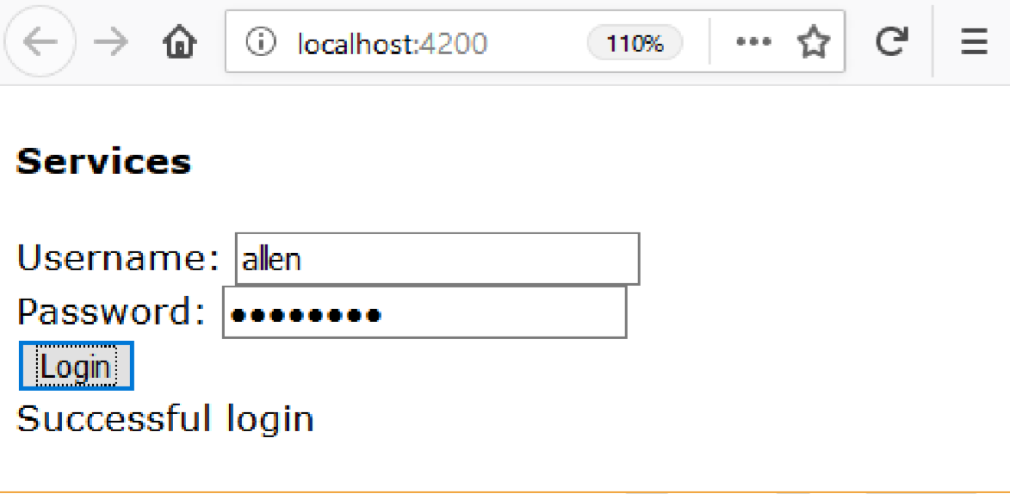
Executing the application:
Open Command Prompt and enter the following commands: cd c:\angular\app1 ng serve
Open the browser and enter the following URL: http://localhost:4200

Slide 10
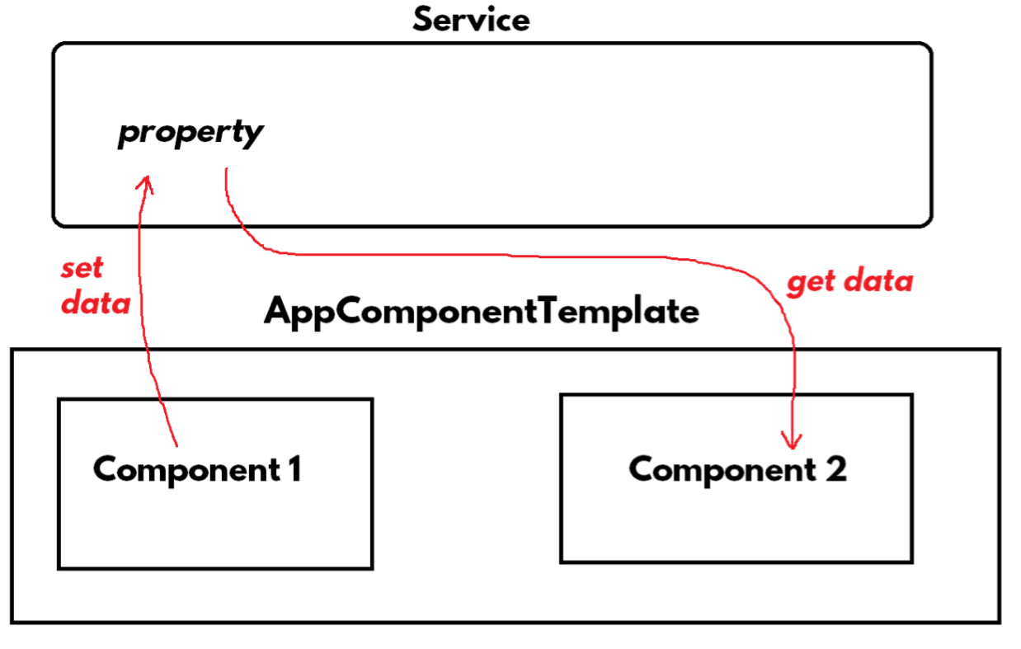
Sharing Data using Services
We can’t share data among sibling components directly; but we can do it by using service.
We can set data from component1 to service; Then the component2 can access data from service.

Slide 11
Sharing Data using Services - Example
Creating Application
Open Command Prompt and enter the following commands:
cd c:\angular ng new app1
cd c:\angular\app1
ng g component India
ng g component Usa
ng g service Population

Slide 12
c:\angular\app1\src\app\app.module.ts
import { BrowserModule } from '@angular/platform-browser’;
import { NgModule } from '@angular/core’;
import { AppComponent } from './app.component’;
import { FormsModule } from "@angular/forms";
import { IndiaComponent } from './india/india.component’;
import { UsaComponent } from './usa/usa.component’;
import { PopulationService } from "./population.service";
@NgModule({
declarations: [ AppComponent, IndiaComponent, UsaComponent ],
imports: [ BrowserModule, FormsModule ],
providers: [ PopulationService ],
bootstrap: [AppComponent]
})
export class AppModule { }

Slide 13
c:\angular\app1\src\app\population.service.ts
import { Injectable } from '@angular/core';
@Injectable() export class PopulationService {
IndiaPopulation: number;
}
c:\angular\app1\src\app\app.component.ts
import { Component } from "@angular/core";
@Component({
selector: 'app-root',
templateUrl: './app.component.html',
styleUrls: ['./app.component.css’]
})
export class AppComponent { }
c:\angular\app1\src\app\app.component.html
<div>
<h4>Sharing Data using Services</h4>
<app-india></app-india>
<app-usa></app-usa>
</div>

Slide 14
c:\angular\app1\src\app\india\india.component.ts
import { Component, OnInit, Inject } from '@angular/core’;
import { PopulationService } from "../population.service";
@Component({
selector: 'app-india',
templateUrl: './india.component.html’,
styleUrls: ['./india.component.css’]
})
export class IndiaComponent implements OnInit {
population: number = 1.32;
constructor(@Inject(PopulationService) private ps : PopulationService) { this.ps.IndiaPopulation = this.population;
}
ngOnInit() { }
}
c:\angular\app1\src\app\india\india.component.html
<div>
<h4>India</h4>
</div>

Slide 15
c:\angular\app1\src\app\usa\Usa.component.ts
import { Component, OnInit, Inject } from '@angular/core’;
import { PopulationService } from "../population.service";
@Component({
selector: 'app-usa',
templateUrl: './usa.component.html',
styleUrls: ['./usa.component.css’]
})
export class UsaComponent implements OnInit {
//indiapopulation: number = 1.32;
constructor(@Inject(PopulationService) private ps : PopulationService) { this.indiapopulation = this.ps.IndiaPopulation;
}
ngOnInit() { } }
c:\angular\app1\src\app\usa\Usa.component.html
<div class="class1">
<h4>United States</h4> India population: {{indiapopulation}} billion.
</div>

Slide 16
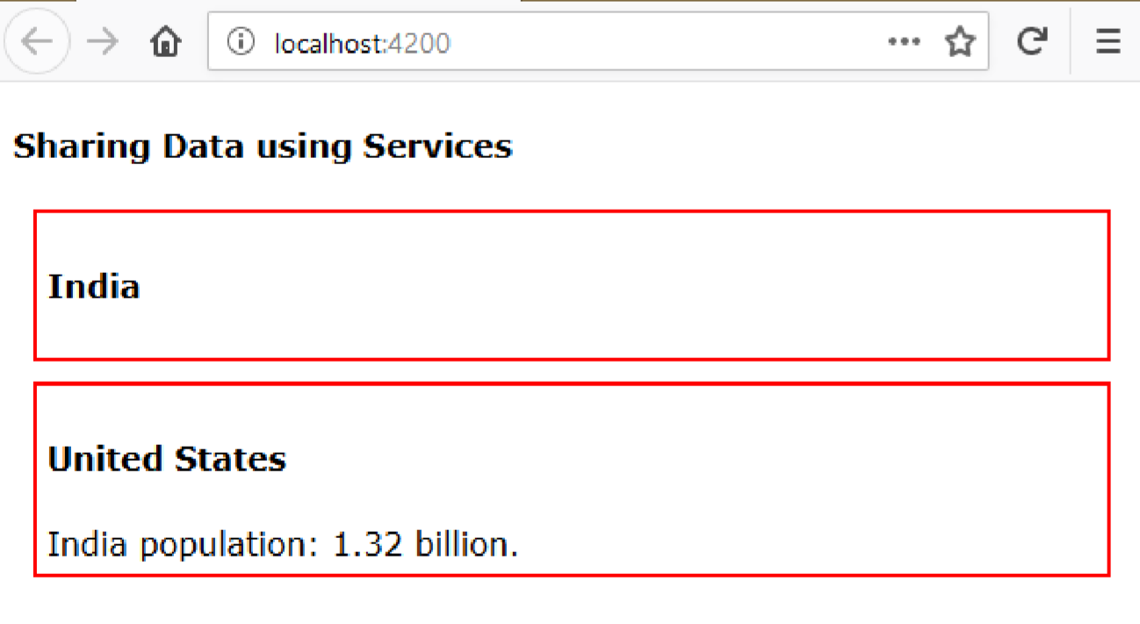
Executing the application:
Open Command Prompt and enter the following commands:
cd c:\angular\app1 ng serve
Open the browser and enter the following URL: http://localhost:4200

